Slide 1

HUMAN RESOURCES
ANALYSIS
VANMATHI K

Slide 2

PROJECT ANALYSIS - MYSQL
Develop a MySQL database to analyze HR data, focusing on employee performance, retention, and satisfaction. This involves creating and managing tables for employee details, performance metrics, retention rates, and feedback scores. Generate SQL queries to identify key trends, high-performing employees, factors affecting retention, and overall employee satisfaction. Provide actionable insights to enhance HR strategies and improve organizational outcomes.

Slide 3

TABLES CONTAINS:
1.General Description
2.Employee Survey
3.Management Survey
4.In Time
5.Out Time

Slide 4


1. Retrieve the total number of employees in the dataset
Query:
SELECT COUNT(EmployeeCount) FROM hr.gd;
Output:

Slide 5
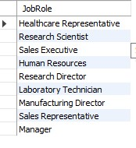
2. List all unique job roles in the dataset.
Query:
SELECT DISTINCT(JobRole) FROM hr.gd;
Output:

Slide 6

3. Find the average age of employees
Query:
SELECT AVG(Age) FROM hr.gd;
Output:

Slide 7
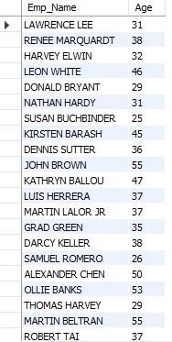
4. Retrieve the names and ages of employees who have worked at the company for more than 5 years
Query:
SELECT Emp_Name , Age FROM hr.gd
WHERE TotalWorkingYears > 5;
Output:

Slide 8

5. Get a count of employees grouped by their department
Query:
SELECT COUNT(EmployeeCount) ,Department FROM hr.gd
GROUP BY Department ;
Output:

Slide 9
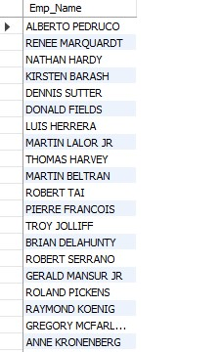
6. List employees who have 'High' Job Satisfaction
Query:
SELECT g.Emp_Name FROM hr.gd as g INNER JOIN hr.`e.survey` as s on g.EmployeeID = s.EmployeeIDWHERE JobSatisfaction = ( SELECT MAX(JobSatisfaction) FROM hr.`e.survey`)
Output:

Slide 10

7. Find the highest Monthly Income in the dataset
Query:
SELECT MAX(MonthlyIncome) FROM hr.gd;
Output:

Slide 11
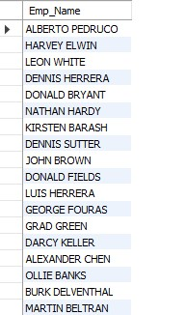
8. List employees who have 'Travel_Rarely' as their BusinessTravel type.
Query:
SELECT MAX(MonthlyIncome) FROM hr.gd;
Output:

Slide 12

9. Retrieve the distinct MaritalStatus categories in the dataset.
Query:
SELECT DISTINCT(MaritalStatus) FROM hr.gd;
Output:

Slide 13
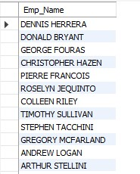
10. Get a list of employees with more than 2 years of work experience but less than 4 years in their current role.
Query:
SELECT Emp_Name FROM hr.gd
WHERE TotalWorkingYears > 2 AND YearsAtCompany < 4;
Output:

Slide 14
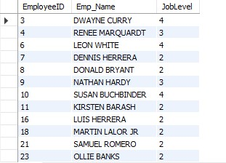
11. List employees who have changed their job roles within the company (JobLevel and JobRole differ from their previous job)
Query:
SELECT EmployeeID, Emp_Name , JobLevel FROM hr.gd
WHERE JobLevel > 1
Output:

Slide 15
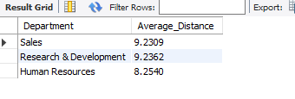
12. Find the average distance from home for employees in each department
Query:
SELECT Department , AVG(DistanceFromHome) Average_Distance FROM hr.gd GROUP BY Department;
Output:

Slide 16
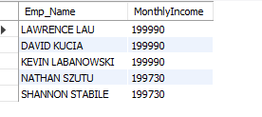
13. Retrieve the top 5 employees with the highest MonthlyIncome.
Query:
SELECT Emp_Name, MonthlyIncome FROM hr.gd
ORDER BY MonthlyIncome DESC
LIMIT 5
Output:

Slide 17

14. Calculate the percentage of employees who have had a promotion in the last year.
Query:
SELECT (COUNT(*)/(SELECT SUM(YearsSinceLastPromotion)) *100) AS PERCENTAGE FROM hr.gd
Output:

Slide 18
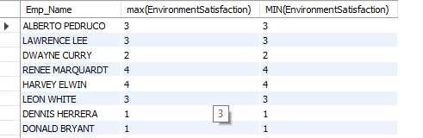
15. List the employees with the highest and lowest EnvironmentSatisfaction.
Query:
SELECT Emp_Name , max(EnvironmentSatisfaction), MIN(EnvironmentSatisfaction) from hr.gd as g INNER JOIN hr.`e.survey` as s on g.EmployeeID = s.EmployeeIDGROUP BY Emp_Name
Output:

Slide 19
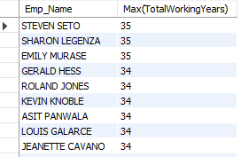
17. List the employees with the highest TotalWorkingYears who also have a PerformanceRating of 4
Query:
SELECT Emp_Name, Max(TotalWorkingYears) FROM hr.gd as g INNER JOIN hr.`m.survey` as s on g.EmployeeID = s.EmployeeIDWHERE PerformanceRating = 4GROUP BY Emp_NameORDER BY Max(TotalWorkingYears) DESC
Output:

Slide 20

18. Calculate the average Age and JobSatisfaction for each BusinessTravel type
Query:
SELECT BusinessTravel, AVG(Age), AVG(JobSatisfaction) FROM hr.gd as g INNER JOIN hr.`e.survey` as s on g.EmployeeID = s.EmployeeIDGROUP BY BusinessTravel
Output:

Slide 21

19. Retrieve the most common EducationField among employees.
Query:
SELECT MAX(EducationField) FROM hr.gd;
Output:

Slide 22
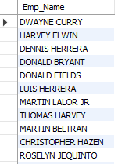
20. List the employees who have worked for the company the longest but haven't had a promotion
Query:
SELECT Emp_Name FROM hr.gdWHERE TotalWorkingYears > 1 AND YearsSinceLastPromotion = 0
Output:

Slide 23

THANK YOU

